Slide 1
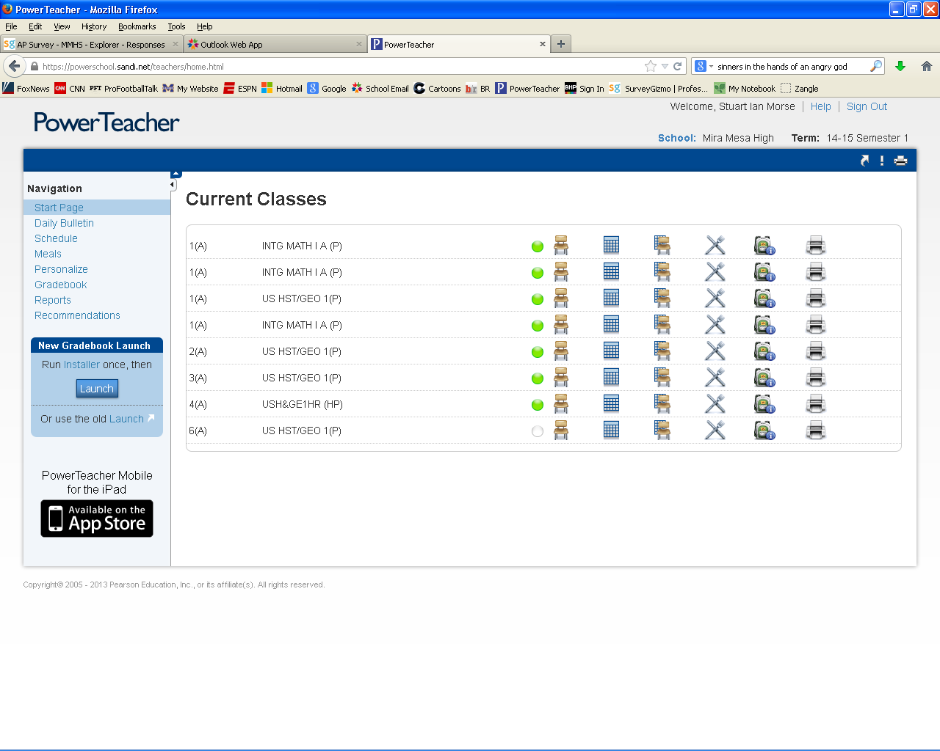
1) Once you have logged into PowerTeacher, click on the chair in front of the grid for the class you want to create a seating chart for.

Slide 2
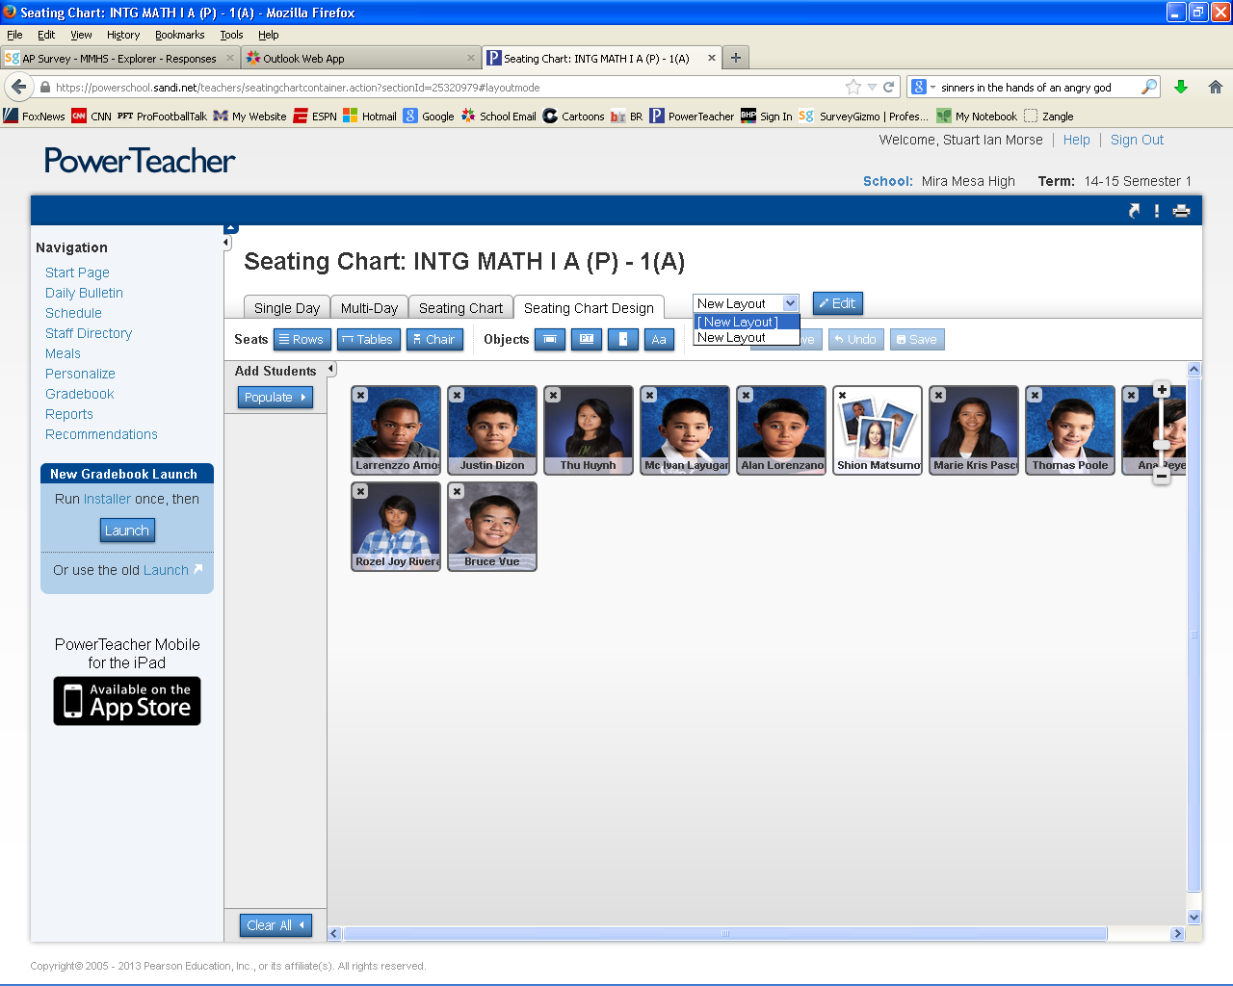
Click on the Seating Chart Design tab
Click the drop-down menu where is says New Layout
Select the option that says [New Layout] (be sure to select the one with the “[ ]”

Slide 3
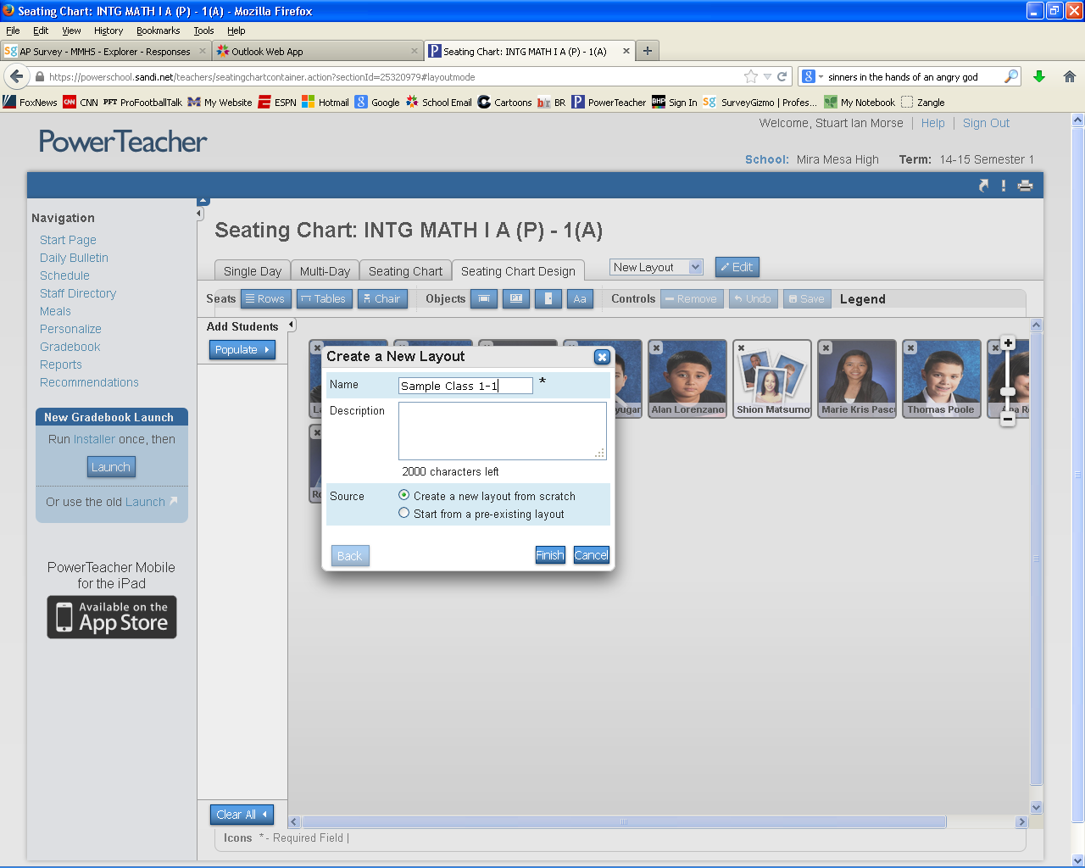
Enter an appropriate name for your seating chart
Select the Create a new layout from scratch
Select Finish

Slide 4
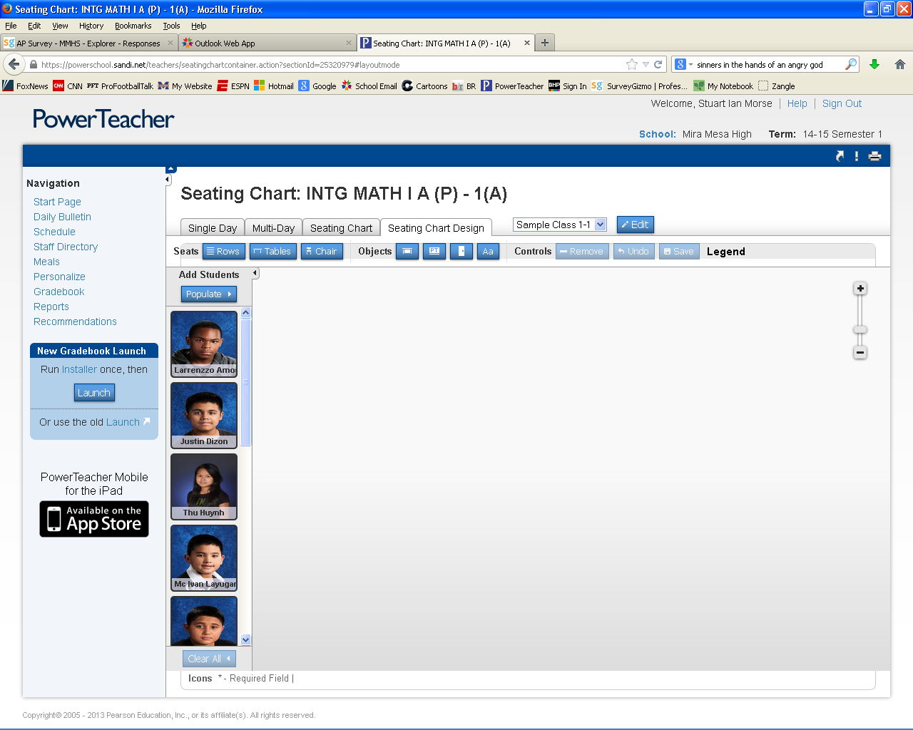
Draw your seating chart by placing rows and columns of chairs or by individually placing tables or chairs.

Slide 5
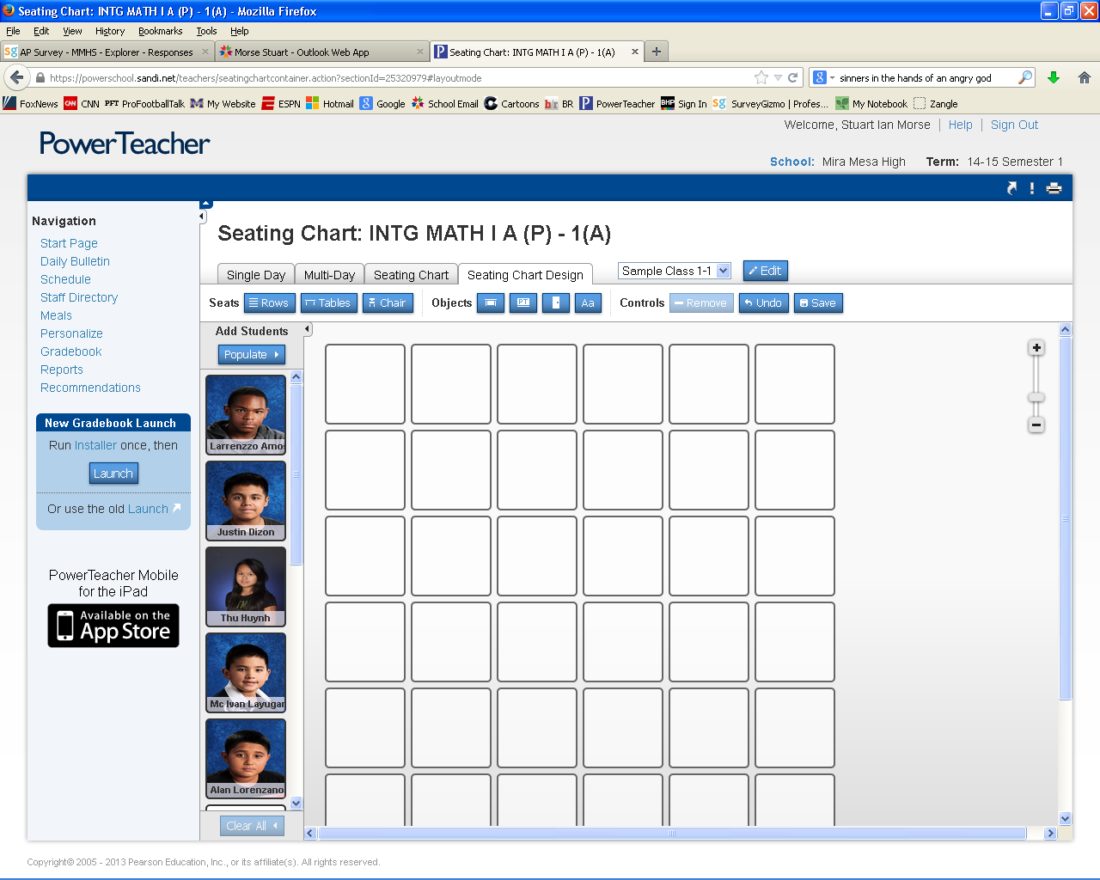
Once you have your desks placed you can rearrange them as desired
To add students select populate or simply drag and drop
Remember to save when finished

Slide 6
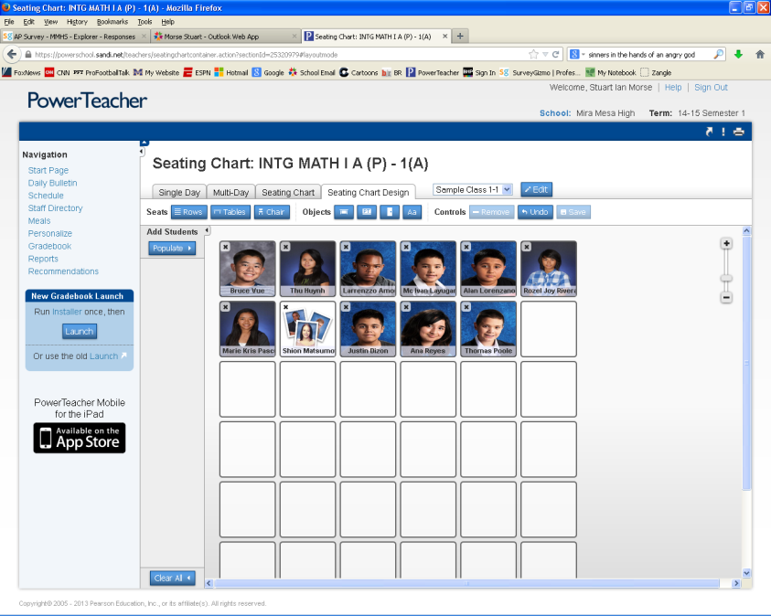
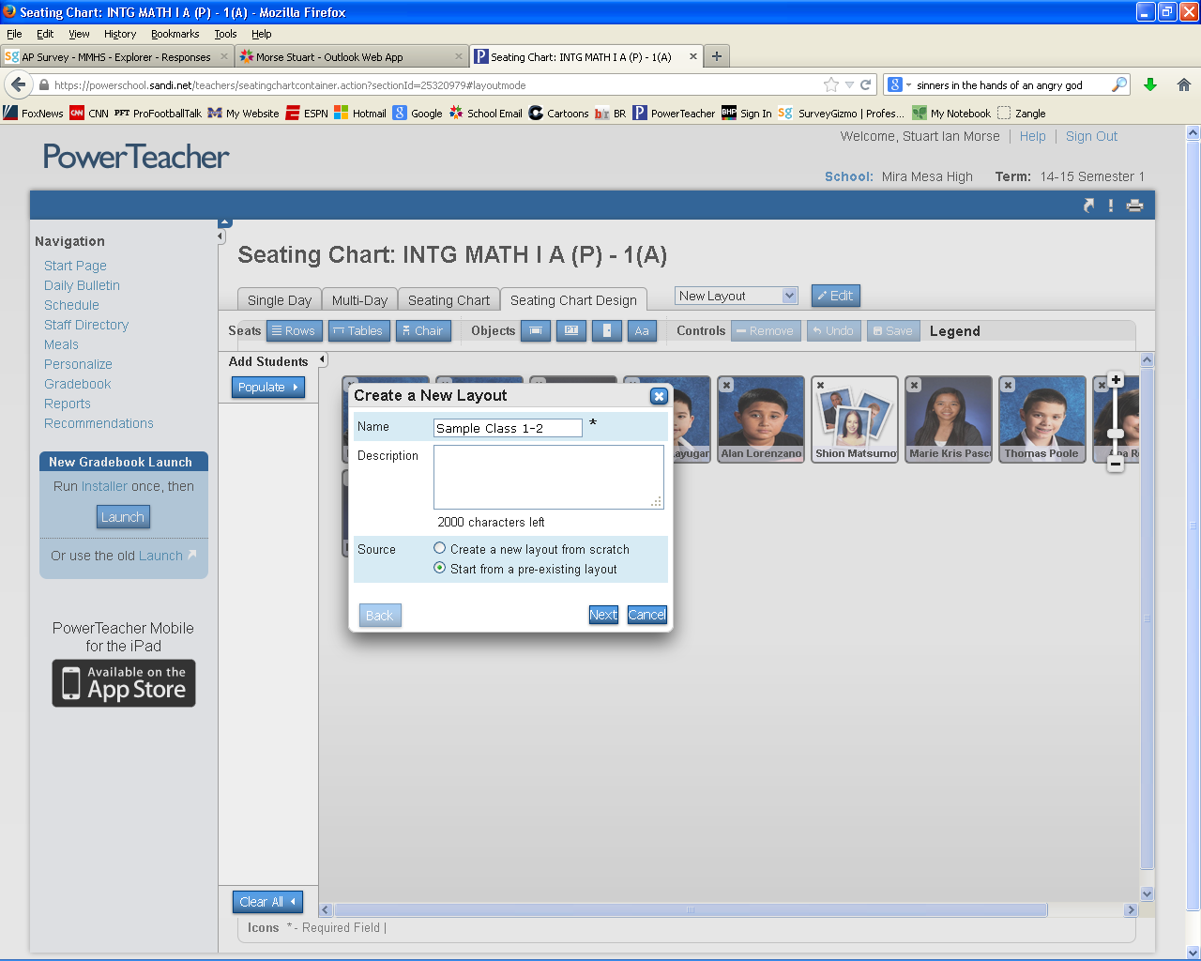
You have now completed a seating chart.
To create a seating chart for more classes, follow the same steps with one exception
3) Instead of creating another identical seating chart, select the Start from a pre-existing layout, then select the name of the seating chart layout you created previously

Slide 7
Displaying Multiple Sections at Once
Click on the chair in front of a grid icon for the class that has multiple sections (is doesn’t matter which section you click)
For this example, I am clicking on Intg Math 1 as it has three sections I want to combine (if you do not know how to create a seating chart, refer to slide 1)

Slide 8
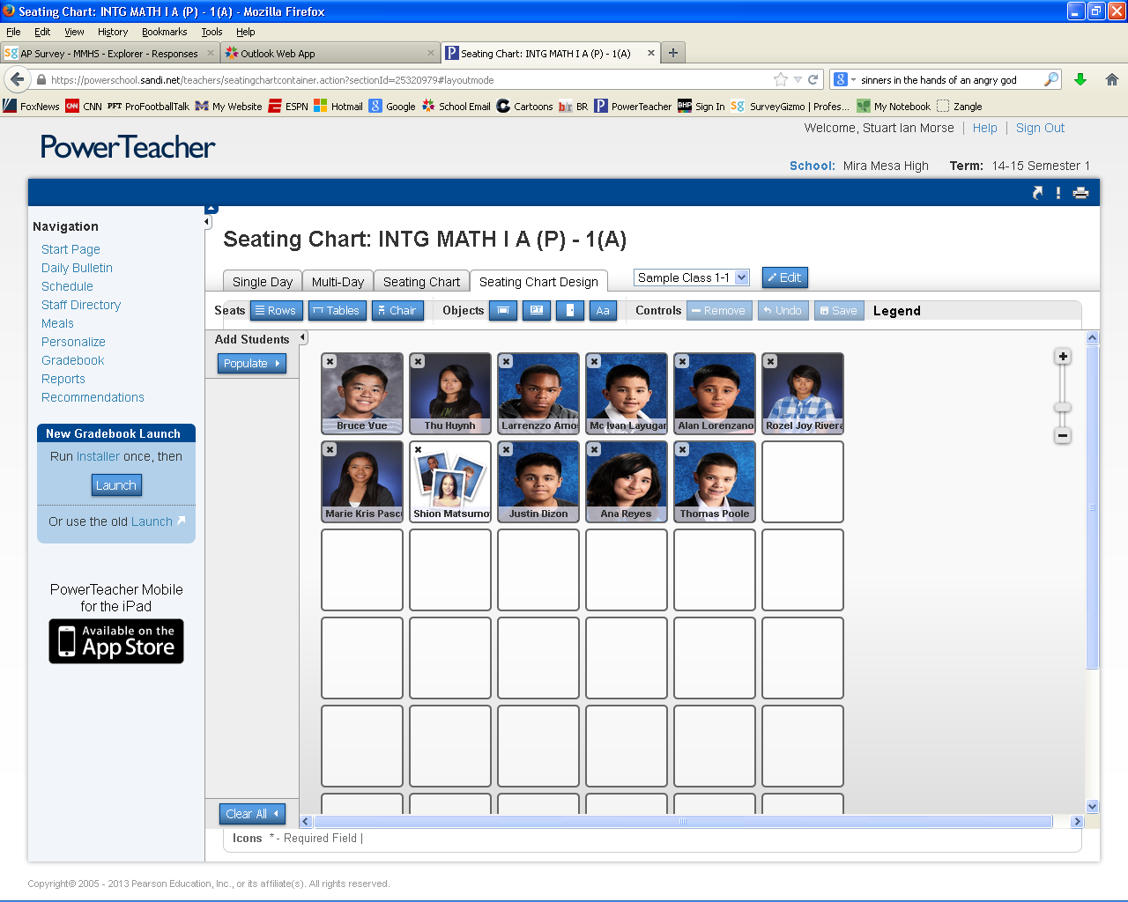
Click Edit

Slide 9
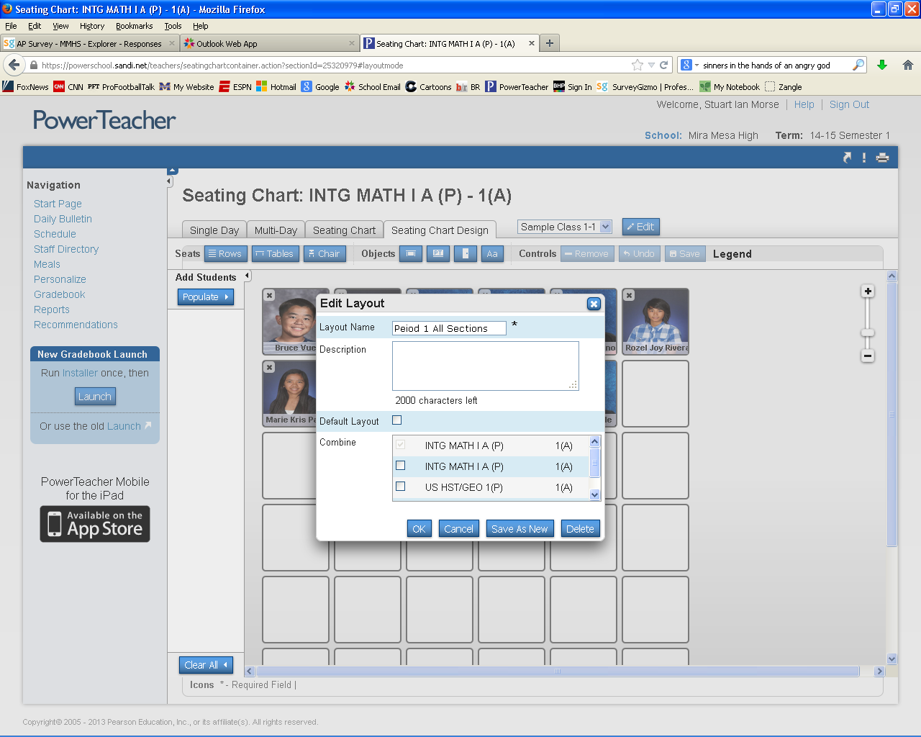
Create an appropriate name for your seating chart
Select the sections you want to be in your seating chart by clicking the box next to the appropriate class
Click Save as New (click continue when the dialog box appears)

Slide 10
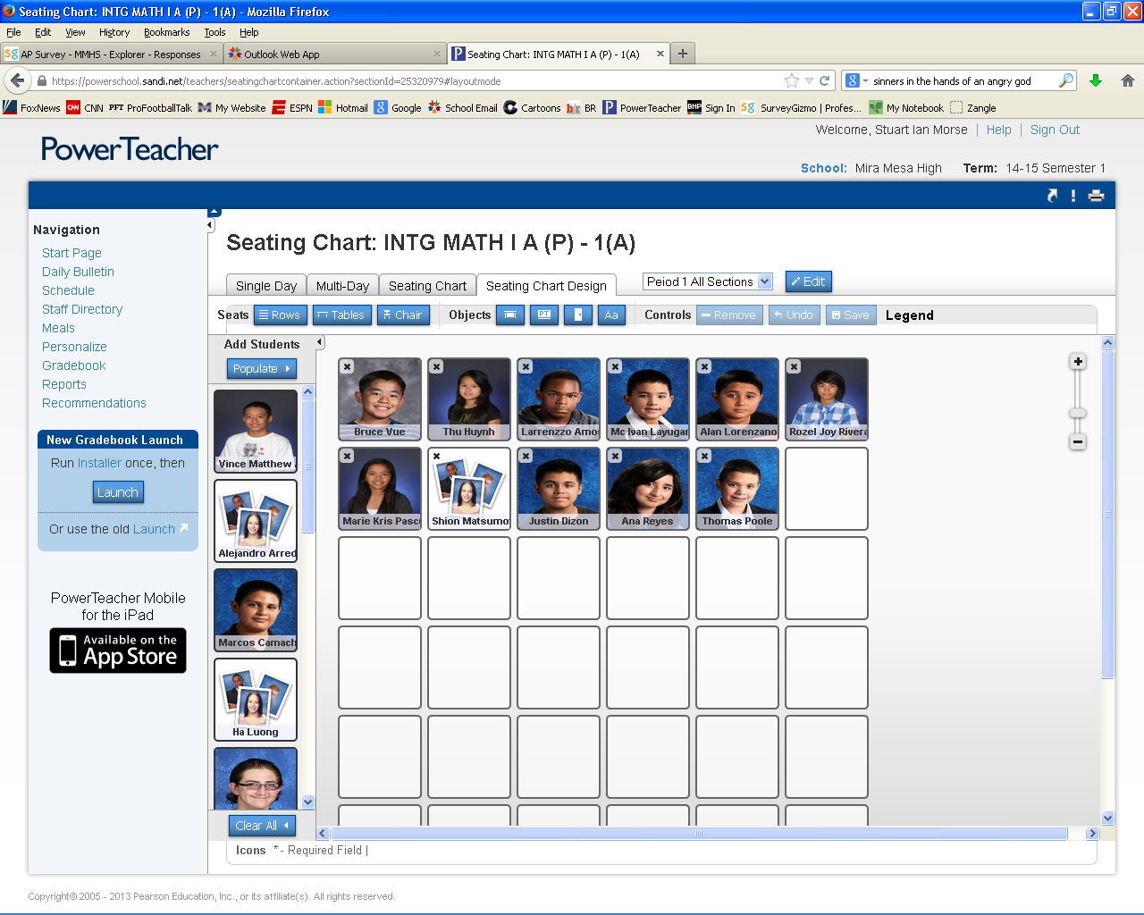
1) Finish by adding students to your seating chart

